Slide 1
Distributed Computing(6)
Remote Method Invocation

Slide 2

Topics
Basics of Java Interface
RMI
Examples

Slide 3
Interface
Definition:
  An interface is a named collection of method definitions (without implementations)
An interface defines a protocol of behavior that can be implemented by any class anywhere in the class hierarchy.

Slide 4
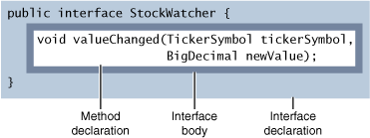
Defining an Interface
an interface definition has two components:
  the interface declaration
  the interface body

Slide 5
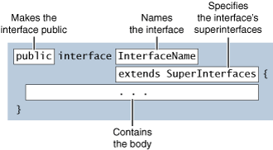
The Interface Declaration
Required elements: the interface keyword and the name of the interface.
Optional elements: list of superinterfaces.

Slide 6
The Interface Body
The interface body contains method declarations and constant declarations
  All methods declared in an interface are implicitly public and abstract ;
  All constant values defined in an interface are implicitly public, static, and final.
  an interface disallow use the private and protected modifiers when declaring members of an interface.

Slide 7
Implementing an Interface
An interface defines a protocol of behavior. A class that implements an interface adheres to the protocol defined by that interface.
When a class implements an interface, either the class must implement all the methods declared in the interface and its superinterfaces, or the class must be declared abstract.

Slide 8
Interface example
public interface Comparable {
public int compareTo(Object o);
}
public class Double implements Comparable{
public int compareTo(Object o) {
……
}
……
}

Slide 9
Using an Interface as a Type
When you define a new interface, you are defining a new reference data type.
Only an instance of a class that implements the interface can be assigned to a reference variable whose type is an interface name.
Example：TestInterface.java

Slide 10
Difference between interface and an abstract class
An interface cannot implement any methods, whereas an abstract class can.
A class can implement many interfaces but can have only one superclass.
An interface is not part of the class hierarchy. Unrelated classes can implement the same interface.

Slide 11
Archetypal Distributed Object Architecture
Object Registry
Object Client
Object Server
Client Proxy
Server Proxy
Run-time Support
Run-time Support
Network Support
Network Support

Slide 12
Java RMI Architecture
The Java Remote Method Invocation (RMI) system allows an object running in one Java Virtual Machine (VM) to invoke methods on an object running in another Java VM. RMI provides for remote communication between programs written in the Java programming language.
The design goal for the RMI architecture was to create a Java distributed object model that integrates naturally into the Java programming language and the local object model.

Slide 13
Interfaces: The Heart of RMI
important principle: the definition of behavior and the implementation of that behavior are separate concepts.
RMI allows the code that defines the behavior and the code that implements the behavior to remain separate and to run on separate JVMs: clients are concerned about the definition of a service and servers are focused on providing the service.

Slide 14
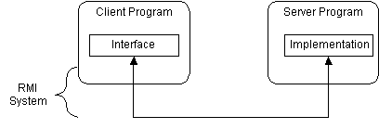
in RMI, the definition of a remote service is coded using a Java interface. The implementation of the remote service is coded in a class .interfaces define behavior and classes define implementation

Slide 15
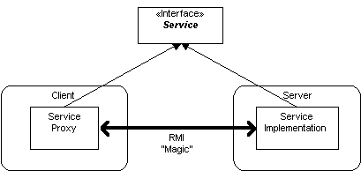
RMI supports two classes :
  The first class is the implementation of the behavior, which runs on the server
  The second class acts as a proxy for the remote service and it runs on the client
A client program makes method calls on the proxy object, RMI sends the request to the remote JVM, and forwards it to the implementation. Any return values provided by the implementation are sent back to the proxy and then to the client's program.

Slide 16
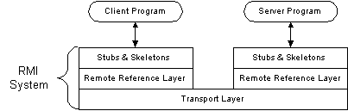
RMI Architecture Layers
Stub and Skeleton Layer
Remote Reference Layer
Transport Layer

Slide 17
Stub and Skeleton Layer
The stub and skeleton layer of RMI lie just beneath the view of the Java developer;
In this layer, RMI uses the Proxy design pattern: an object in one context is represented by another (the proxy) in a separate context.The proxy knows how to forward method calls between the participating objects;
the stub class plays the role of the proxy, and the remote service implementation class plays the role of the RealSubject;
The skeleton understands how to communicate with the stub across the RMI link. The skeleton carries on a conversation with the stub; it reads the parameters for the method call from the link, makes the call to the remote service implementation object, accepts the return value, and then writes the return value back to the stub.

Slide 18
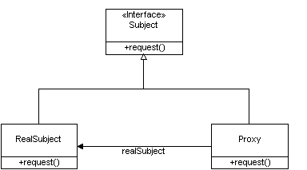

Slide 19
Remote Reference Layer
The Remote Reference Layers defines and supports the invocation semantics of the RMI connection;
This layer provides a RemoteRef object that represents the link to the remote service implementation object;
The stub objects use the invoke() method in RemoteRef to forward the method call. The RemoteRef object understands the invocation semantics for remote services;
The JDK 1.1 provides a unicast, point-to-point connection: before a client can use a remote service, the remote service must be instantiated on the server and exported to the RMI system. The Java 2 SDK supports activatable remote objects.

Slide 20
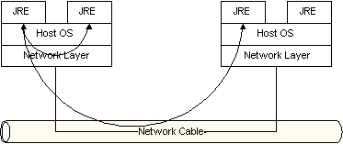
Transport Layer
The Transport Layer makes the connection between JVMs. All connections are stream-based network connections that use TCP/IP.

Slide 21
Naming Remote Objects
How does a client find an RMI remote service? Clients find remote services by using a naming or directory service.
The RMI Registry runs on each machine that hosts remote service objects and accepts queries for services, by default on port 1099.
a server program creates a remote service by
  creating a local object that implements that service.
  exporting that object to RMI registers the object in the RMI Registry under a public name.
  registers the object in the RMI Registry under a public name.
a client uses Naming.lookup(String URL) to query a registry
  Parameter URL: rmi://<host_name> [:<name_service_port>] /<service_name>
  Return Value: a remote reference to the service object

Slide 22
Remote Interfaces, Objects, and Methods
Remote objects: Objects have methods that can be called across virtual machines.
An object becomes remote by implementing a remote interface, which has the following characteristics :
  A remote interface extends the interface java.rmi.Remote
  Each method of the interface declares java.rmi.RemoteException in its throws clause, in addition to any application-specific exceptions.
only those methods defined in a remote interface are available to be called in the receiving virtual machine.

Slide 23
Creating Distributed Applications Using RMI
Design and Implement the Application Components
  Defining the remote interfaces
  Implementing the remote objects
  Implementing the clients
Compile Sources and Generate Stubs
  use the javac compiler to compile the source files
  use the rmic compiler to create stubs for the remote objects
Make Classes Network Accessible
  Make remote interfaces, stubs, and other classes that need to be downloaded to clients--accessible via a Web server
Start the Application
  running the RMI remote object registry, the server, and the client

Slide 24
Defining the remote interfaces
The interface extends Remote
each method signature declares that it may throw a RemoteException object.
Example:Calculator.java

Slide 25
Implementing the remote objects
Declare the remote interfaces being implemented
Define the constructor for the remote object
Provide an implementation for each remote method in the remote interfaces
Example: CalculatorImpl.java

Slide 26
UnicastRemoteObject
UnicastRemoteObject can be used as a superclass for remote object implementations
The constructor of UnicastRemoteObject exports the remote object to accept client calls;
A remote object implementation does not have to extend UnicastRemoteObject, but:
  must make an explicit call to one of UnicastRemoteObject's exportObject methods to make the RMI runtime aware of the remote object so that the object can accept incoming calls

Slide 27
Host Server
instantiate the remote object
Register remote object in RMI registry. Naming.rebind(String name,Remote obj)
  name is a URL-formatted java.lang.String representing the location and the name of the remote object.
  The RMI runtime substitutes a reference to the stub for the remote object reference specified by the argument.
  an application can bind, unbind, or rebind remote object references only with a registry running on the same host.
Example: CalculatorServer.java

Slide 28
Creating a Client Program
looks up a Compute remote object by using public static Remote lookup(String name);
Gets a reference of the remote object;
invokes the method of the Compute remote object.
Example: CalculatorClient.java

Slide 29
Compile Sources and Generate Stubs
Compile Sources
  javac Calculator.java
  javac CalculatorImpl.java
  javac CalculatorServer.java
  javac CalculatorClient.java
Generate Stubs
  rmic CalculatorImpl

Slide 30
Running the RMI System
start three consoles, one for the server, one for the client, and one for the RMIRegistry
  Start with the Registry , You must be in the directory that contains the classes you have written:
  C:\Calculator\rmiregistry
  In the second console start the server hosting the CalculatorService:
  C:\Calculator\java CalculatorServer
  In the last console, start the client program:
  C:\Calculator\java CalculatorClient

Slide 31
Parameters in RMI
Does RMI support pass-by-value or pass-by-reference? The answer depends on whether the parameters are primitive data types, objects, or remote objects.

Slide 32
Parameters in a Single JVM
The normal semantics for Java technology is pass-by-value
  Primitive Parameters;
  Object Parameters;
Example: PassingParam.java

Slide 33
Primitive Parameters in RMI
When a primitive data type is passed as a parameter to a remote method, the RMI system passes it by value.
Values are passed between JVMs in a standard, machine-independent format. This allows JVMs running on different platforms to communicate with each other reliably.

Slide 34
Object Parameters in RMI
RMI sends the object itself, not its reference, between JVMs. It is the object that is passed by value, not the reference to the object.
Passing large object graphs can use a lot of CPU time and network bandwidth.
Object Serialization is used to transform an object into a linear format that can then be sent over the network wire; Serialized objects can be de-serialized in the memory of the remote JVM.
example: RMIParameters/*.java

Slide 35
Remote Object Parameters in RMI
A client program can obtain a reference to a remote object through the RMI Registry program. A reference can also be returned to the client from a method call.
When a method returns a local reference to an exported remote object, RMI does not return that object. Instead, it substitutes another object (the remote proxy for that service) in the return stream.

Slide 36
BankManager bm;
Account a;
try {
bm = (BankManager) aming.lookup(
"rmi://BankServer/BankManagerService");
a = bm.getAccount( "jGuru" );
// Code that uses the account
}catch (RemoteException re) {
}
public Account getAccount(String accountName) {
// Code to find the matching account
AccountImpl ai =
// return reference from search
return AccountImpl;
}

Slide 37
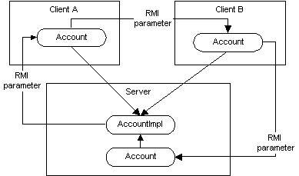
Return a remote reference from Server to Client A
Send the remote reference from Client A to Client B
Send the remote reference from Client B back to Server

Slide 38
Remote Object Parameters in RMI--Example
using Factory design pattern to get Remote Object (City/*)
  Remote interface: CityFactory.java, City.java;
  Remote Object: CityFactoryImpl.java, CityImpl.java;
  Server: CityServer.java;
  Client: CityClient.java;

Slide 39
RMI Client-side Callbacks
In many architectures, a server may need to make a remote call to a client. Examples include progress feedback, time tick notifications, warnings of problems, etc.
A client must also act as an RMI server
The key to server is to get a reference to remote object in the client.
example: callback/*.java

Slide 40
Distributing and Installing RMI Software
RMI adds support for a Distributed Class model to the Java platform and extends Java technology's reach to multiple JVMs.
It should not be a surprise that installing an RMI system is more involved than setting up a Java runtime on a single computer.

Slide 41
Distributing RMI Classes(1)
For the server
  Remote service interface definitions
  Remote service implementations
  Skeletons for the implementation classes (JDK 1.1 based servers only)
  Stubs for the implementation classes (before JDK 1.4)
  Client classes for objects used by server the (such as parameters)
  All other server classes

Slide 42
Distributing RMI Classes(2)
For the client
  Remote service interface definitions
  Stubs for the remote service implementation classes
  Server classes for objects used by the client (such as return values)
  All other client classes

Slide 43
Automatic Distribution of Classes
The RMI designers extended the concept of class loading to include the loading of classes from FTP servers and HTTP servers.
RMI supports this remote class loading through the RMIClassLoader. If a client or server is running an RMI system and it sees that it must load a class from a remote location, it calls on the RMIClassLoader to do this work.

Slide 44
java.rmi.server.codebase
java -Djava.rmi.server.codebase=URL <ClassName>
This URL points to a file:, ftp:, or http: location that supplies classes for objects that are sent from this JVM.
If a program running in a JVM sends an object to another JVM , that other JVM needs to load the class file for that object.
When RMI sends the object via serialization, RMI embeds the URL specified by this parameter into the stream, alongside of the object.
Note: RMI does not send class files along with the serialized objects.

Slide 45
different RMI system configurations
Closed. All classes used by clients and the server must be located on the JVM and referenced by the CLASSPATH environment variable. No dynamic class loading is supported.
Server based. A client applet is loaded from the server's CODEBASE along with all supporting classes.
Client dynamic. The primary classes are loaded by referencing the CLASSPATH environment variable of the JVM for the client. Supporting classes are loaded by the RMIClassLoader from an HTTP or FTP server on the network at a location specified by the server.

Slide 46
another example: compute engine
compute/Compoute.java
compute/Task.java
engine/ComputeEngine.java
client/ComputePi.java
client/Pi.java

Slide 47
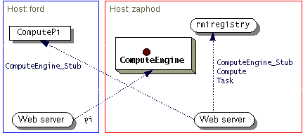
Obtaining classes during program execution

Slide 48
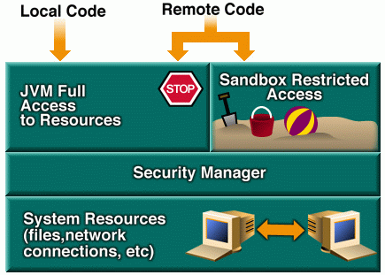
Java Security Architecture (1)
JDK 1.0 Security Model
  local code is trusted to have full access to vital system resources, but downloaded remote code (an applet) is not trusted and can access only the limited resources provided inside the sandbox.

Slide 49
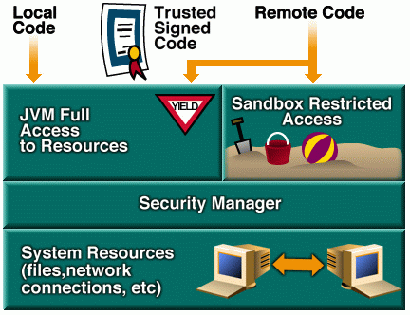
Java Security Architecture (2)
JDK 1.1 Security Model
  JDK 1.1 introduced the concept of a “signed applet”. A digitally signed applet is treated like local code, with full access to resources, if the public key used to verify the signature is trusted.

Slide 50
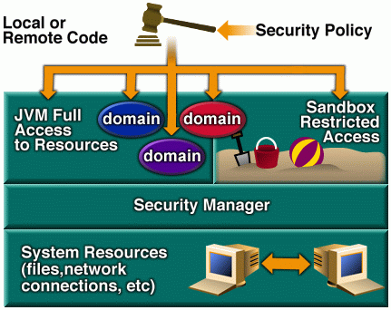
Java Security Architecture (3)
JDK 1.2 Security Model
  all code, regardless of whether it is local or remote, can now be subject to a security policy.
  The runtime system organizes code into individual domains, each of which encloses a set of classes whose instances are granted the same set of permissions.

Slide 51
Security Policy File
general policy file
  Connect to or accept connections on unprivileged ports (ports greater than 1024) on any host
  Connect to port 80 (the port for HTTP)
grant {
permission java.net.SocketPermission "*:1024-65535",
"connect,accept";
permission java.net.SocketPermission "*:80", "connect";
};

Slide 52
grant {
permission java.net.SocketPermission "*:1024-65535",
"connect,accept";
permission java.io.FilePermission
"c:\\home\\ann\\public_html\\classes\\-", "read";
};
java -Djava.security.policy=java.policy engine.ComputeEngine
java -Djava.security.policy=java.policy client.ComputePi

Slide 53
The Difference between local objects and remote objects
Object Definition
  A local object is defined by a Java class.
  A remote object's exported behavior is defined by an interface that must extend the Remote interface.
Object Implementation
  A local object is implemented by its Java class.
  A remote object's behavior is executed by a Java class that implements the remote interface.

Slide 54
Object Creation
  A new instance of a local object is created by the new operator.
  A new instance of a remote object is created on the host computer with the new operator. A client cannot directly create a new remote object.
Object Access
  A local object is accessed directly via an object reference variable.
  A remote object is accessed via an object reference variable which points to a proxy stub implementation of the remote interface.
References
  In a single JVM, an object reference points directly at an object in the heap.
  A "remote reference" is a pointer to a proxy object (a "stub") in the local heap. That stub contains information that allows it to connect to a remote object, which contains the implementation of the methods.

Slide 55
Active References
  In a single JVM, an object is considered "alive" if there is at least one reference to it.
  In a distributed environment, remote JVMs may crash, and network connections may be lost. A remote object is considered to have an active remote reference to it if it has been accessed within a certain time period (the lease period). If all remote references have been explicitly dropped, or if all remote references have expired leases, then a remote object is available for distributed garbage collection.
Finalization
  If an object implements the finalize() method, it is called before an object is reclaimed by the garbage collector.
  If a remote object implements the Unreferenced interface, the unreferenced method of that interface is called when all remote references have been dropped.

Slide 56
Garbage Collection
  When all local references to an object have been dropped, an object becomes a candidate for garbage collection.
  The distributed garbage collector works with the local garbage collector. If there are no remote references and all local references to a remote object have been dropped, then it becomes a candidate for garbage collection through the normal means.
Exceptions
  Exceptions are either Runtime exceptions or Exceptions. The Java compiler forces a program to handle all Exceptions.
  RMI forces programs to deal with any possible RemoteException objects that may be thrown. This was done to ensure the robustness of distributed applications.

